Slide 1

MAFS 5440 Project 2 Optional Topic: Large Language Models for Financial Analysis
Discover how cutting-edge AI agent technology is revolutionizing investment management through multi-agent systems that simulate legendary investors' strategies.

Slide 2

Understanding LLMs in Finance
What Are LLMs?
Financial Applications
Large Language Models utilize transformer architectures trained on massive datasets, enabling them to recognize, translate, predict, and generate text and other content with remarkable accuracy.
In finance, LLMs automate complex analysis tasks by processing vast amounts of heterogeneous data—news articles, research reports, financial statements, earnings calls, and real-time market data—to extract valuable insights and identify patterns difficult for human analysts to detect at scale.

Slide 3

The AI Hedge Fund Project
We recommend exploring this repo https://github.com/virattt/ai-hedge-fund,
a highly acclaimed open-source project with over 42,000 GitHub stars that demonstrates the practical application of LLMs in investment management.
42K
12
4
GitHub Stars
Investor Agents
Analytical Agents
Highly acclaimed open-source project
Specialized AI agents with distinct philosophies
Valuation, Sentiment, Fundamentals, Technicals

Slide 4





Multi-Agent Architecture
The system implements a sophisticated multi-agent architecture where different AI agents simulate the investment philosophies and decision-making processes of renowned investors, working together to make informed trading decisions.
Investor Agents
Analytical Agents
12 specialized agents embodying distinct investment philosophies
4 agents analyzing valuation, sentiment, fundamentals, and technicals
Portfolio Manager
Risk Manager
Orchestrates final trading decisions based on agent inputs
Evaluates portfolio vulnerabilities and risk exposure

Slide 5

Value Investing Agents
Ben Graham
Charlie Munger
Focuses on margin of safety principles, seeking stocks trading below intrinsic value with significant downside protection.
Emphasizes wonderful businesses at fair prices, prioritizing quality companies with sustainable competitive advantages.
Michael Burry
Mohnish Pabrai
Contrarian deep value approach, identifying overlooked opportunities through intensive research and analysis.
Seeks low-risk doubles with asymmetric risk-reward profiles and high probability of success.

Slide 6

Growth & Strategic Investors
Growth Investing Agents
Strategic Investors
Cathie Wood: Innovation and disruption focus, targeting transformative technologies
Bill Ackman: Activist investing approach with concentrated positions
Stanley Druckenmiller: Macro and asymmetric opportunities with flexible strategies
Phil Fisher: Growth through research, emphasizing quality management and products
Peter Lynch: Ten-baggers in everyday businesses, finding growth in familiar companies
Rakesh Jhunjhunwala: Indian market specialist with long-term perspective

Slide 7
Project Direction 1: Implement a New Investment Agent
Develop and integrate a new AI agent based on your favorite investor or a unique investment philosophy.
For this direction, we expect you to codify the investment strategy you have the deepest understanding and quantify it with back-testing.
01
02
Research Investment Principles
Implement Decision Logic
Study your chosen investor's philosophy—Ray Dalio's principles-based approach, George Soros's reflexivity theory, or David Tepper's distressed debt strategies.
Code the agent's decision-making using appropriate prompting strategies that capture the investor's unique approach.
03
04
Integrate into Framework
Backtest and Evaluate
Connect your new agent with the existing multi-agent system for collaborative decision-making.
Test performance across different market conditions and compare with existing agents to understand philosophical differences.

Slide 8

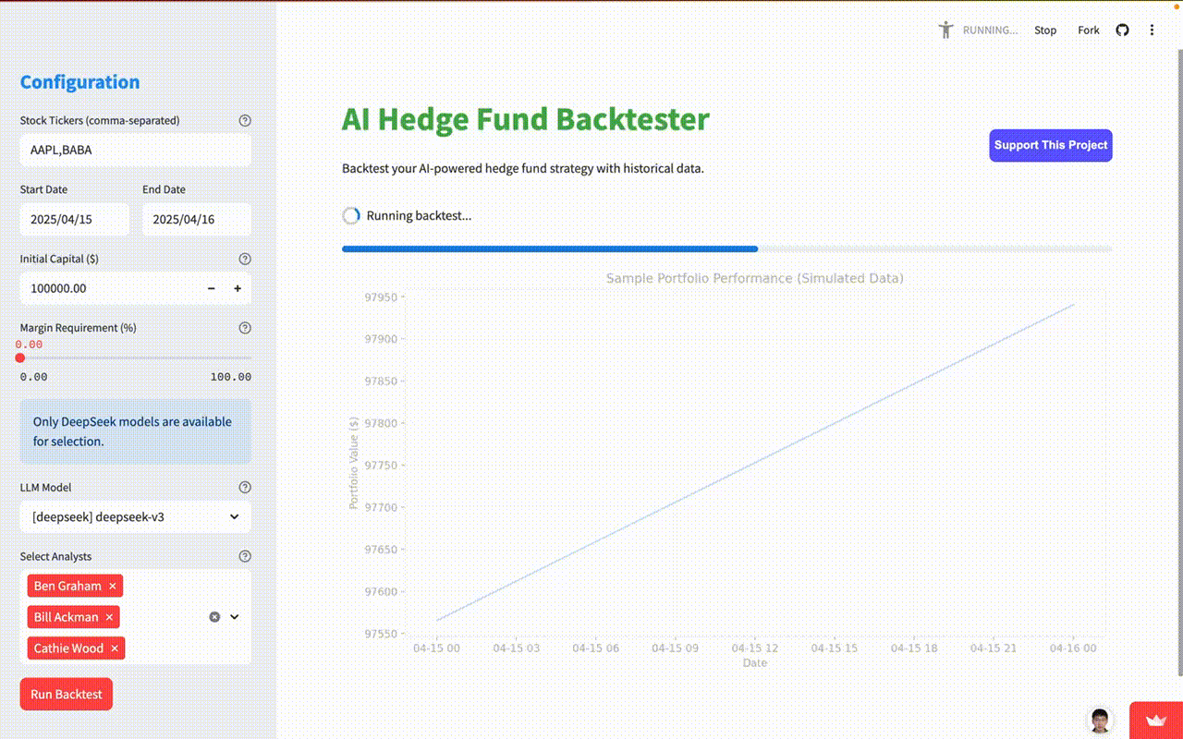
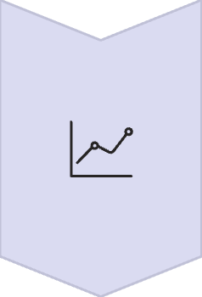


Starting Point: a Streamlit App
Leverage the existing Streamlit-based user interface to enhance visualization of agent decisions, compare strategies, and analyze portfolio performance metrics. This project involves both understanding existing code and developing new features: https://github.com/fuxiaoyi/ai-hedge-fund-plus.
Data Integration
Expand connections to new data sources for compre-
-hensive financial metrics and agent-specific outputs.
Visualization Enhancement
Design and implement intuitive charts and graphs to display
complex financial data and agent performance clearly.
Interactive Features
Add dynamic filters, sliders, and controls for real-time
comparison of investment strategies and scenario analysis.
Insight Generation
Develop features that highlight key insights and actionable
recommendations from the visualized data, aiding decision-making.

Slide 9
Project Direction 2: Novel Financial Applications
Extend the AI hedge fund framework to create innovative applications in financial investments.
Your creativity is encouraged.
Sector-Specific Analysis
Risk Management Systems
ESG Integration
Develop specialized agents for specific sectors like biotech, renewable energy, or cryptocurrency with domain-specific knowledge.
Create advanced risk assessment agents that identify portfolio vulnerabilities and suggest hedging strategies.
Implement environmental, social, and governance factors into investment decision-making processes.
Alternative Data Integration
Market Regime Detection
Incorporate satellite data, social media sentiment, or patent filings into investment analysis.
Develop agents that identify changing market conditions and adapt strategies accordingly.

Slide 10
Previous Student Projects
We list two successful implementations by previous students who have created noval LLMs based financial analysis applications (using the AI hedge fund framework is OPTIONAL).
Financial News Analysis
Fundamental Analysis
An application that generates various reports on S&P 500 stocks. The system collects news data from a free API, indexes it using LlamaIndex, and uses OpenAI's backend to produce insights.
Integrates LlamaIndex, and GPT-4 to process vast amounts of financial data, to provide in-depth, accessible insights into company performance, market trends, and meeting minutes.
View Project Demo →
View Project Demo →
Your application is expected to demonstrate both technical sophistication and practical relevance to financial markets.

Slide 11



Submission Requirements
Written Report
Source Materials
Exclude Large Files
Include demonstration of your demo application and necessary analysis
Provide zip folder with main logic codes and essential files
Do not include large data files such as checkpoint weights

Slide 12

Additional Resources
•TradingAgents: Multi-Agents LLM Financial Trading Framework (Paper) https://arxiv. org/pdf/2412.20138
•TradingAgents Framework -https://github.com/TauricResearch/TradingAgents
• Financial Agent - GitHub Repository https://github.com/virattt/financial-agent
• Financial Analyst App - GPT-4, Streamlit, and Llama-Index Tutorial https://youtu.be/ c_LAIkkhKts?si=zbyANC91SymDJuV3
• LlamaIndex starter tutorial https://gpt-index.readthedocs.io/en/latest/getting_started/ starter_example.html
• HKUST Azure OpenAI API service https://itso.hkust.edu.hk/services/it-infrastructure/ azure-openai-api-service
• Other API services: https://api.bianxie.ai, AI/ML API:https://aimlapi.com
• FinGPT-ForecasterHuggingface Space Demo https://huggingface.co/spaces/FinGPT/ FinGPT-Forecaster
• Huggingface Generation with LLMs tutorial https://huggingface.co/docs/transformers/ llm_tutorial

